Slide 1
DEEP LEARNING (IT549) Overview on Generative Adversarial Network (GAN)
Bakul Gohel, Ph.D.
DA-IICT, Gandhinagar

Slide 2
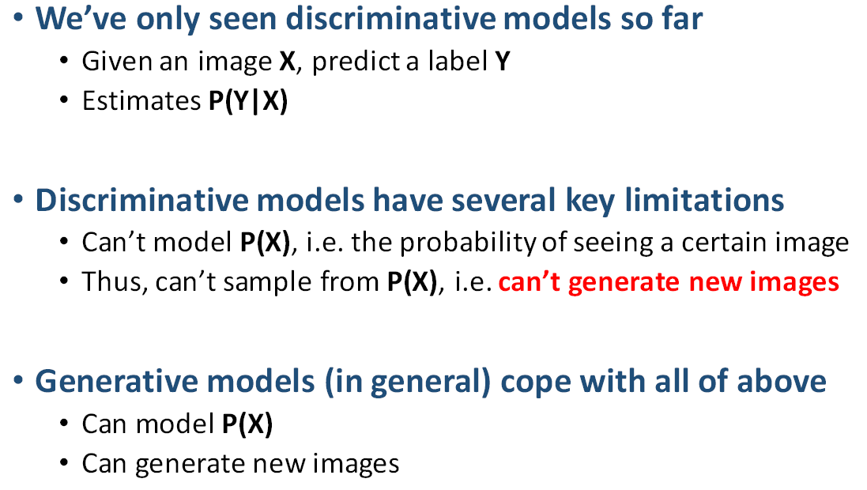
GAN

Slide 3
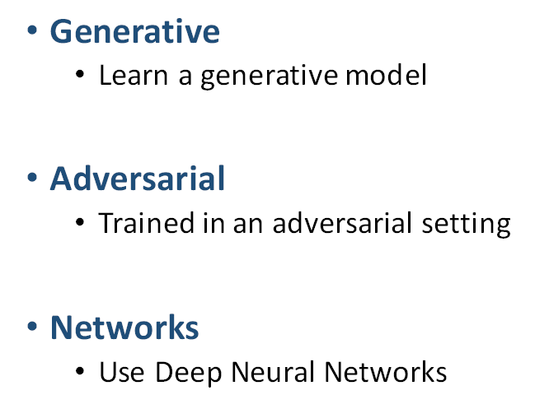
GAN

Slide 4
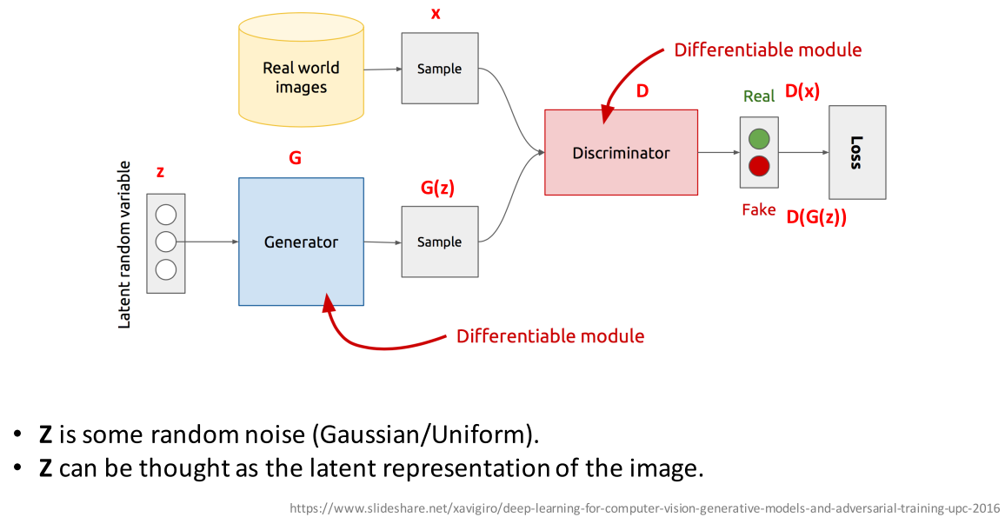
GAN architecture

Slide 5
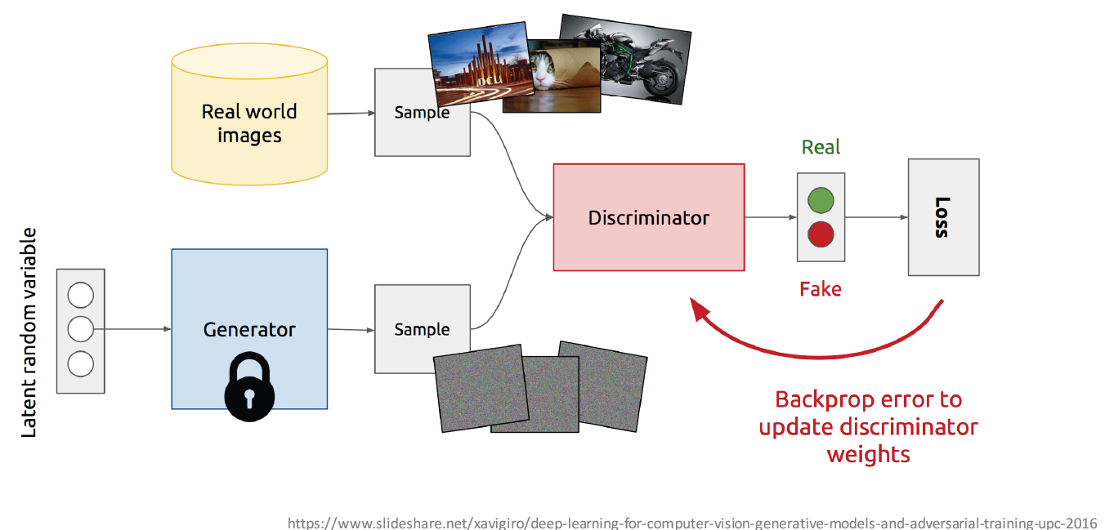
Training Discriminator

Slide 6
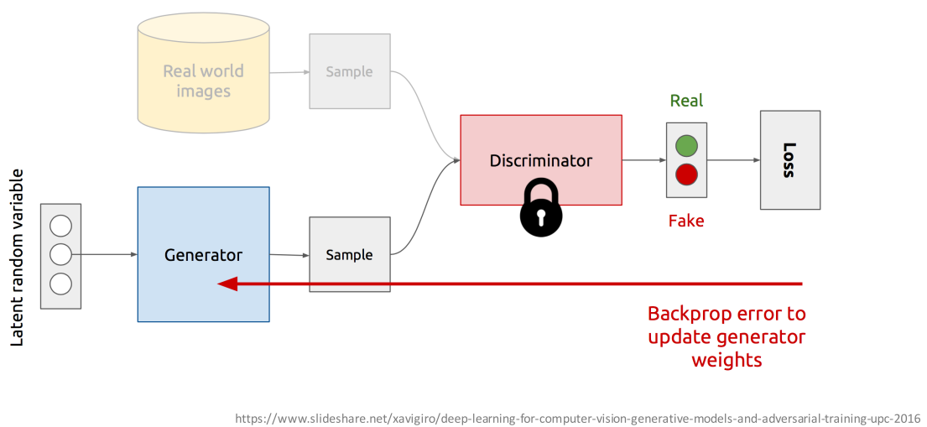
Training Generator

Slide 7
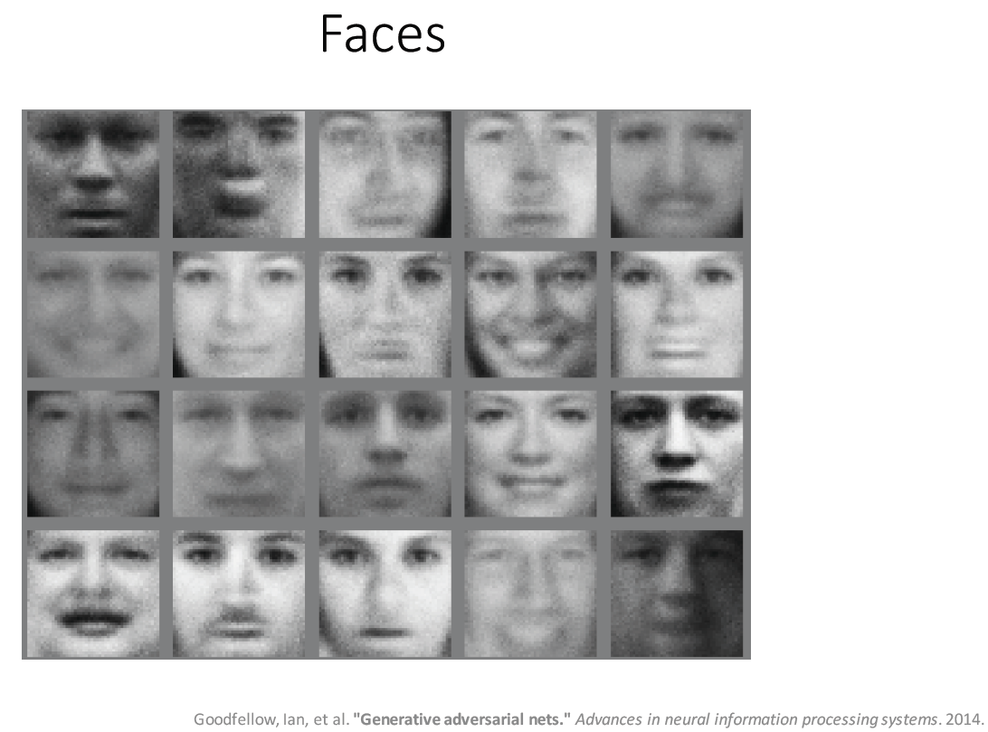
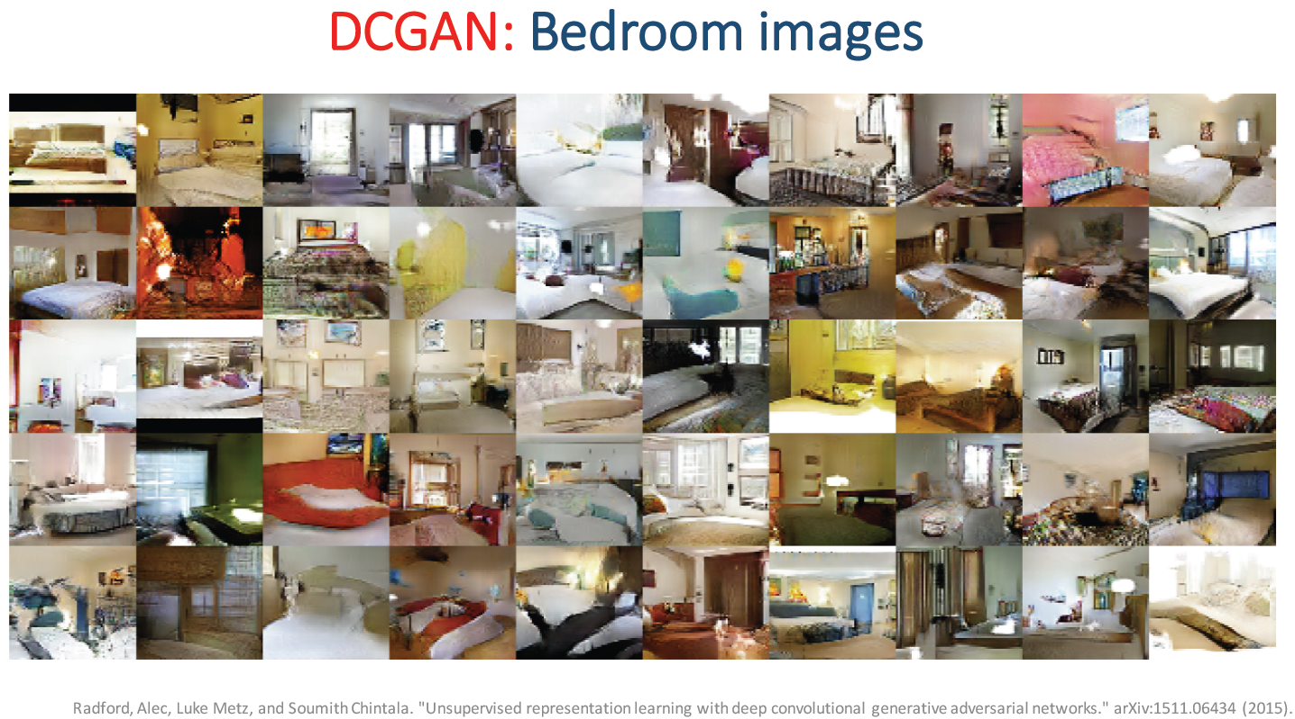
GAN - Images from noise

Slide 8
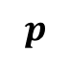
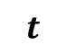
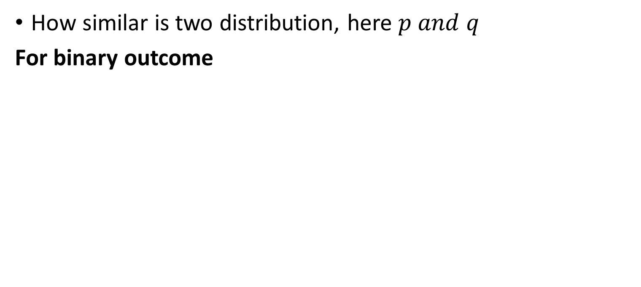
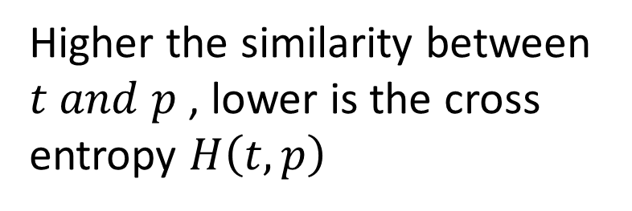
Cross Entropy
$$cross entropy=H\left(p,q\right)=−\sum_{a}{p\left(a\right)log⁡(q(a))}$$
How similar is two distribution, here $p and q$
For binary outcome
1
$binary cross entropy=H\left(t,p\right)=−$( $tlog⁡(p)$ + $(1−t)log⁡(1−p)$ )
1
Higher the similarity between $t and p$ , lower is the cross entropy $H\left(t,p\right)$
$$t$$
0
$$p$$
1

Slide 9
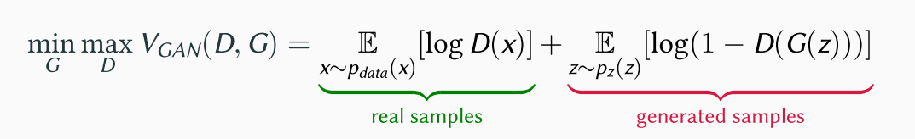
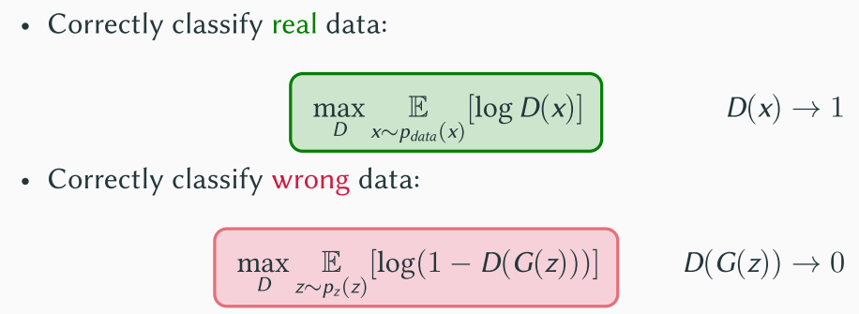
GAN Loss function / Optimization
LOSS= binary-cross entropy, ACTIVATION=sigmoid

Slide 10
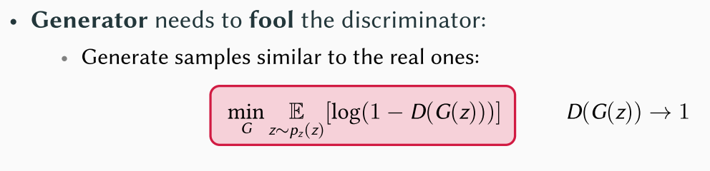
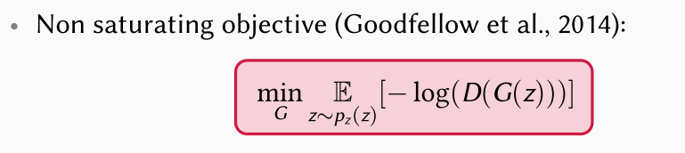
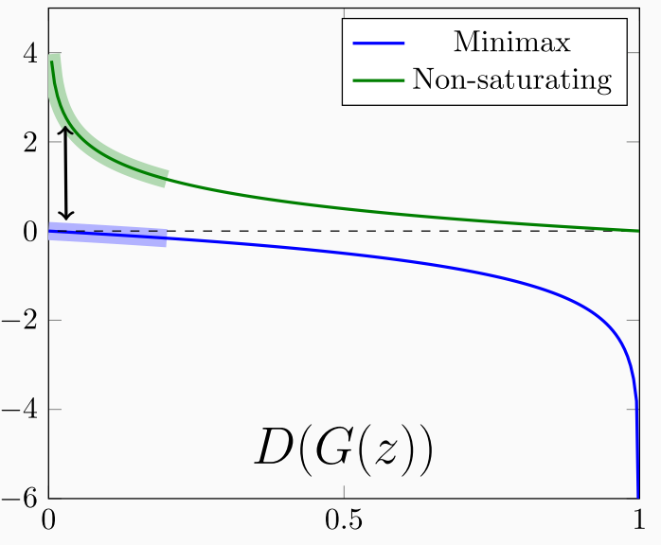
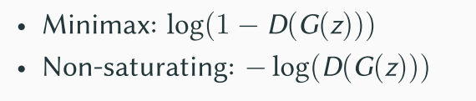
GAN Loss function / Optimization

Slide 11
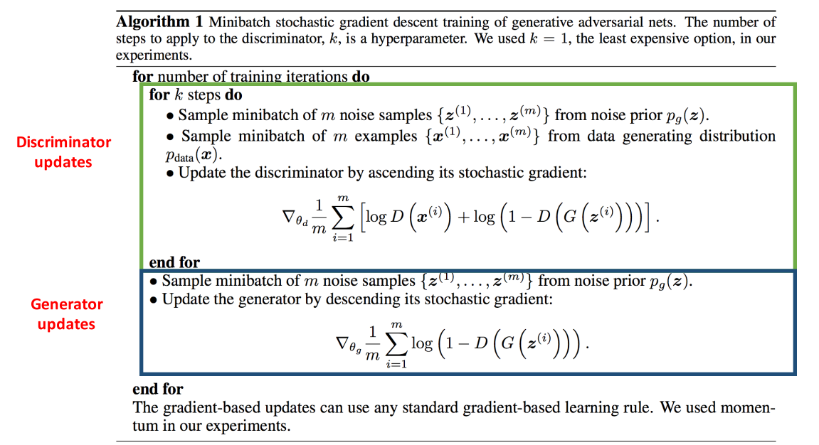
GAN Training

Slide 12
GAN Training – let’s make it simple
Overall, discriminator training is the binary classification problem
Activation function at output layer : sigmoid
Loss function : binary cross entropy
Minimize the loss
For generator training, goal is to predict fake as a real
If the label of generated fake data is “zero” then we need to maximize the loss e.g. binary cross entropy
How about regressing fake to real
if label of generated fake data is set to “one” then we need to minimize the binary cross entropy as did above

Slide 13
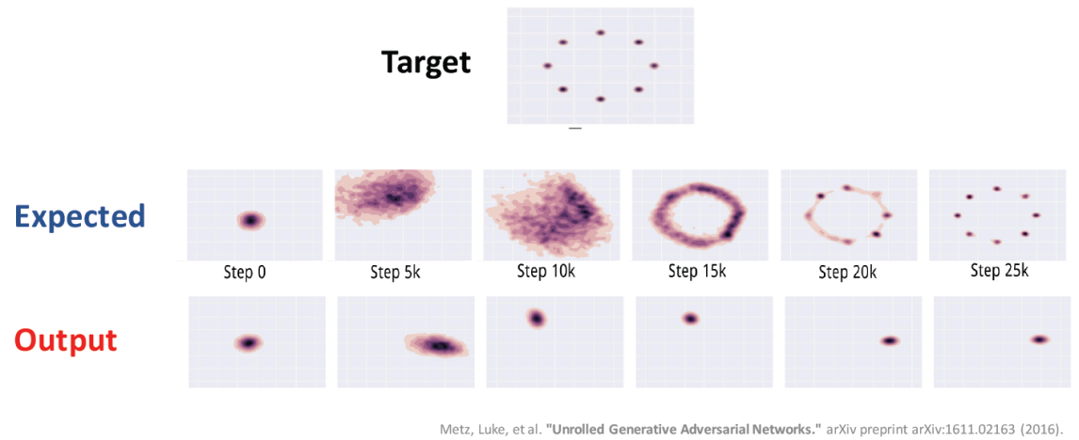
problem with GAN
Non convergence
GAN is the two players game; if one wins the other loses ; counter adaptive or reactive process
Vanishing gradient
Mode collapse
generator collapses which produces limited varieties of samples
Highly dependent of hyper-parameter settings

Slide 14
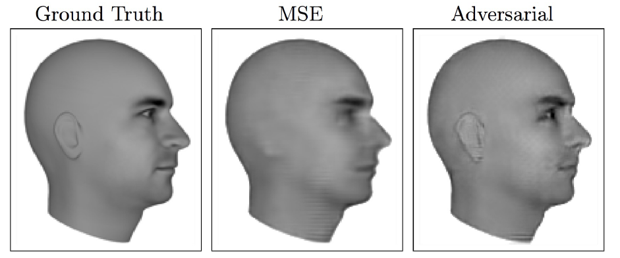
GAN
Advantages
Sampling (or generation) is straightforward
Robust to Overfitting since Generator never sees the training data
Empirically, GANs are good at capturing the modes of the distribution.
Predicting next from previous frame

Slide 15
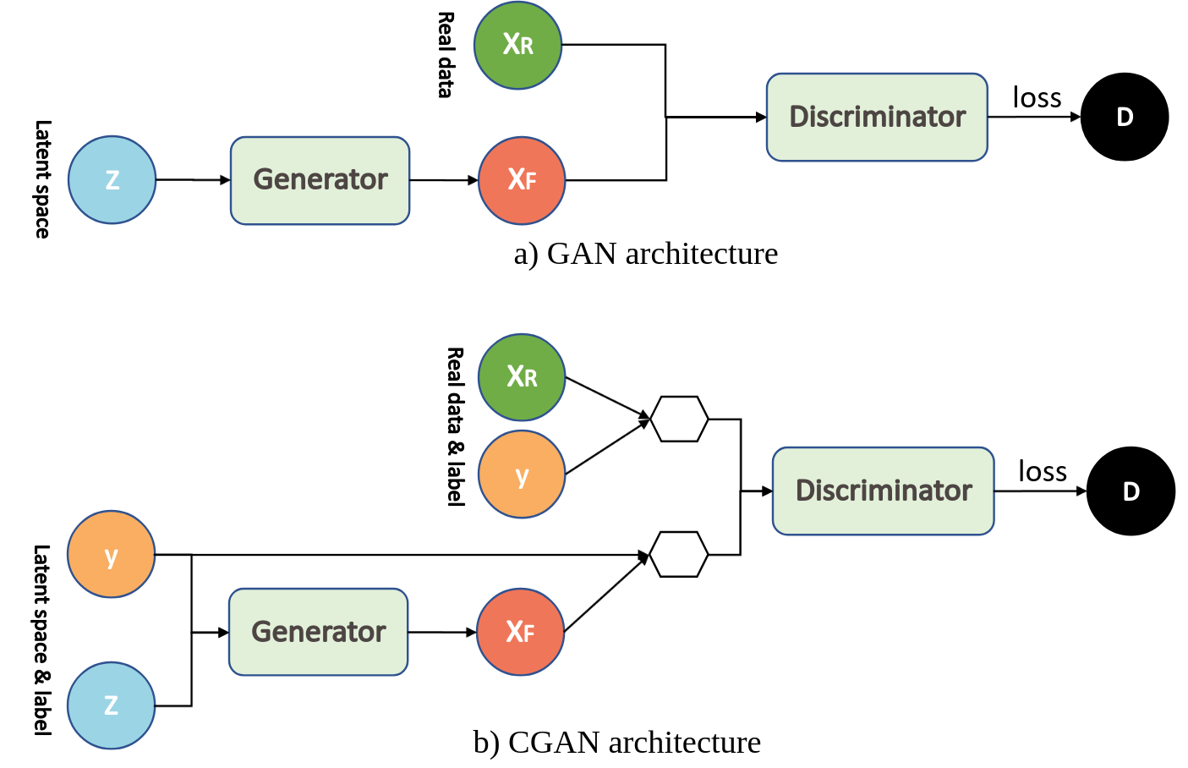
Conditional GAN

Slide 16
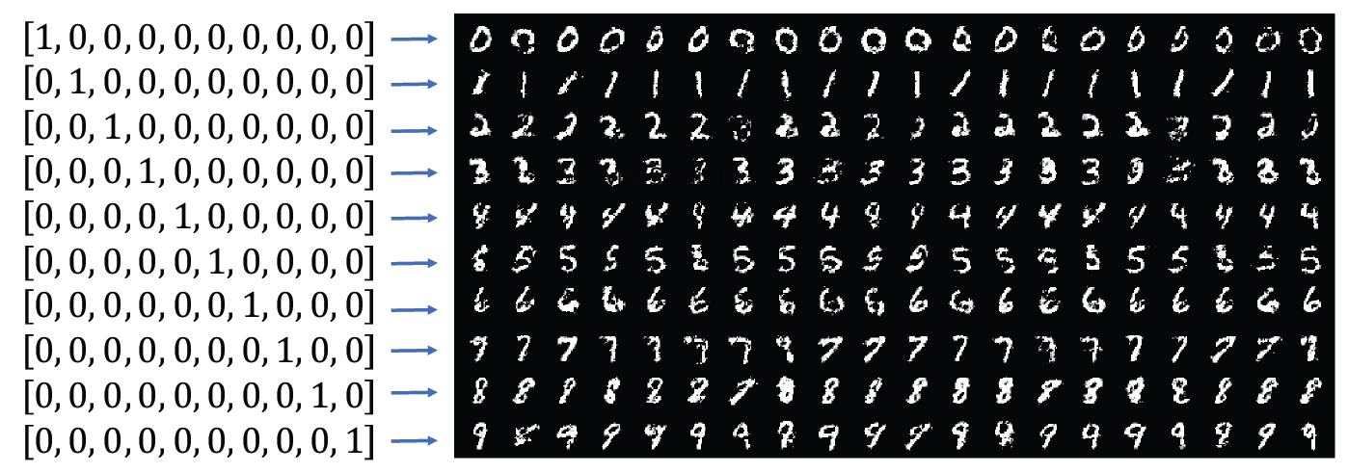
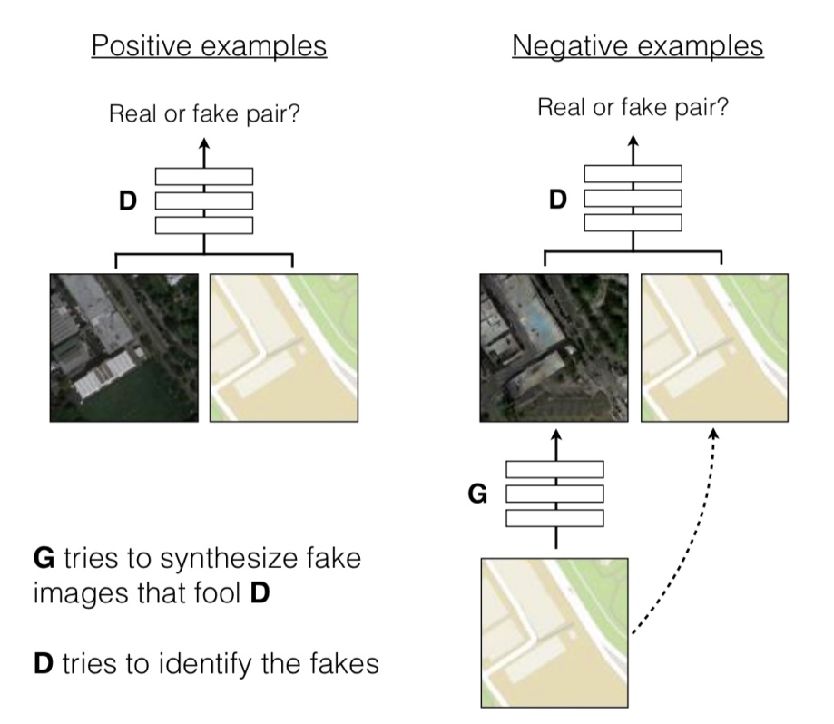
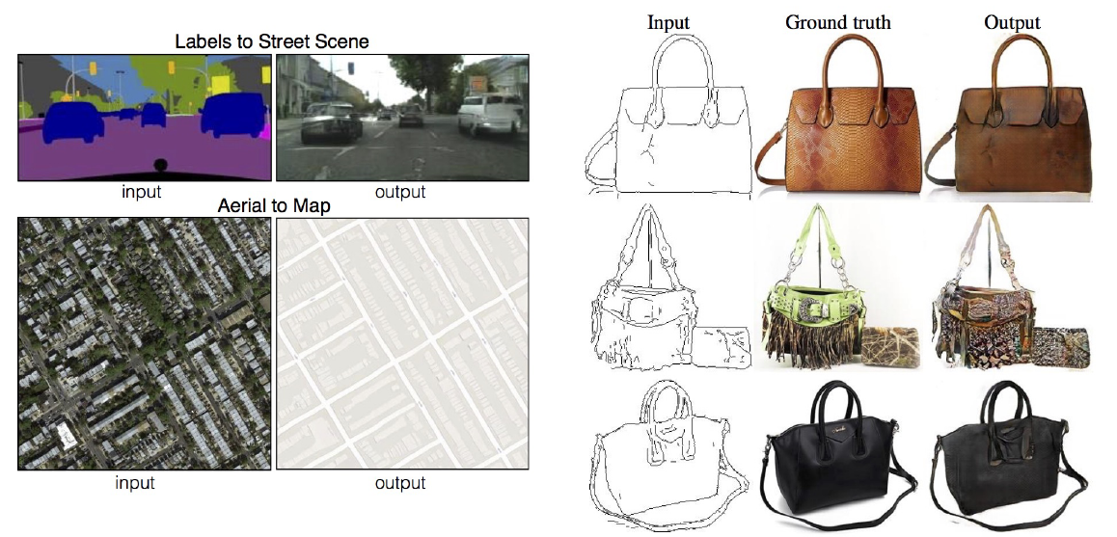
Conditional GAN

Slide 17
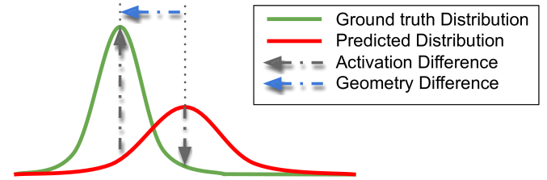
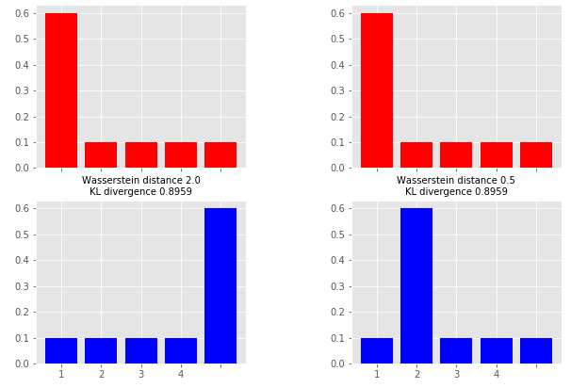
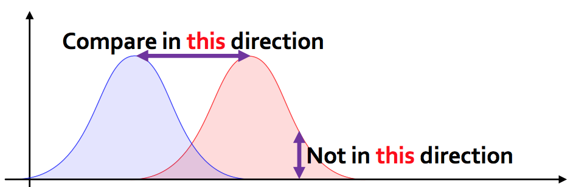
Wasserstein GAN
KL divergence
Wasserstein
Wasserstein
therefor…

Slide 18
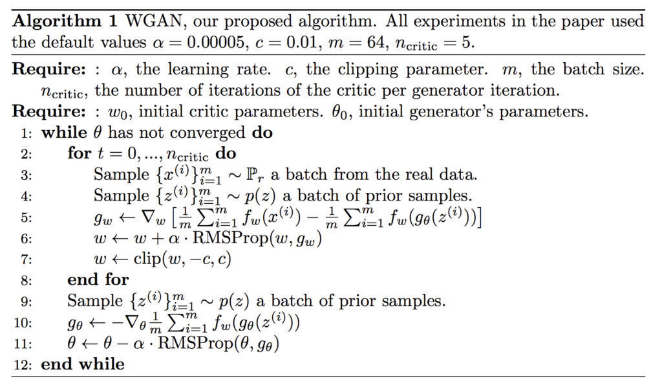
Wasserstein GAN

Slide 19
GAN APPLICATION
Generate Examples for Image Datasets
Generate Photographs of Human Faces
Generate Realistic Photographs
Generate Cartoon Characters
Image-to-Image Translation
Text-to-Image Translation
Semantic-Image-to-Photo Translation
Face Frontal View Generation
Generate New Human Poses
Photos to Emojis
Photograph Editing
Face Aging
Photo Blending
Super Resolution
Photo Inpainting
Clothing Translation
Video Prediction
3D Object Generation
MANY APPLICATIONS
It’s a fun !
Source: https://machinelearningmastery.com/impressive-applications-of-generative-adversarial-networks/

Slide 20
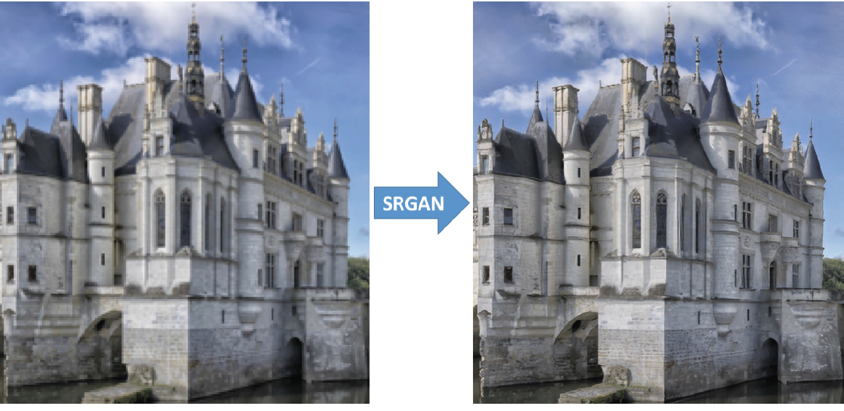
GAN APPLICATION

Slide 21
View-points
Numerous different architectures of GAN in the literature / market – application specific medication of vanilla GAN / conditional GAN
Much affords or debates on loss function for GAN, some says none is better than else, some says we need a careful evaluation of loss function
I think whenever you think of auto-encoder in your application, application of GAN may be useful
GAN is the GAME
Minimum loss is not our aim

